Slide 1
Coursera Capstone Project
Clustering of London Underground Stations

Slide 2
Background
Tourism is a vital part of the UK economy, accounting for 9.6% of jobs (https://www.visitbritain.org/visitor-economy-facts).
London represents 55% of the tourism market, hosting a record 19.8m visits in 2017 (https://www.visitbritain.org/nation-region-county-data).
Each visitor spending on average £683.
This report will cluster London Underground stations in zones 1 and 2 to help tourists and businesses plan the best route around the city.

Slide 3
Method And Data
This project was carried out using a Jupyter Notebook
The data sources used were:
4Square API for extracting venues nearby underground stations.
Doogal (https://www.doogal.co.uk/london_stations.php) which provides a list of all London Underground stations as a CSV file.
4Square was queried using their API and London Underground station Lat/Long as input.

Slide 4
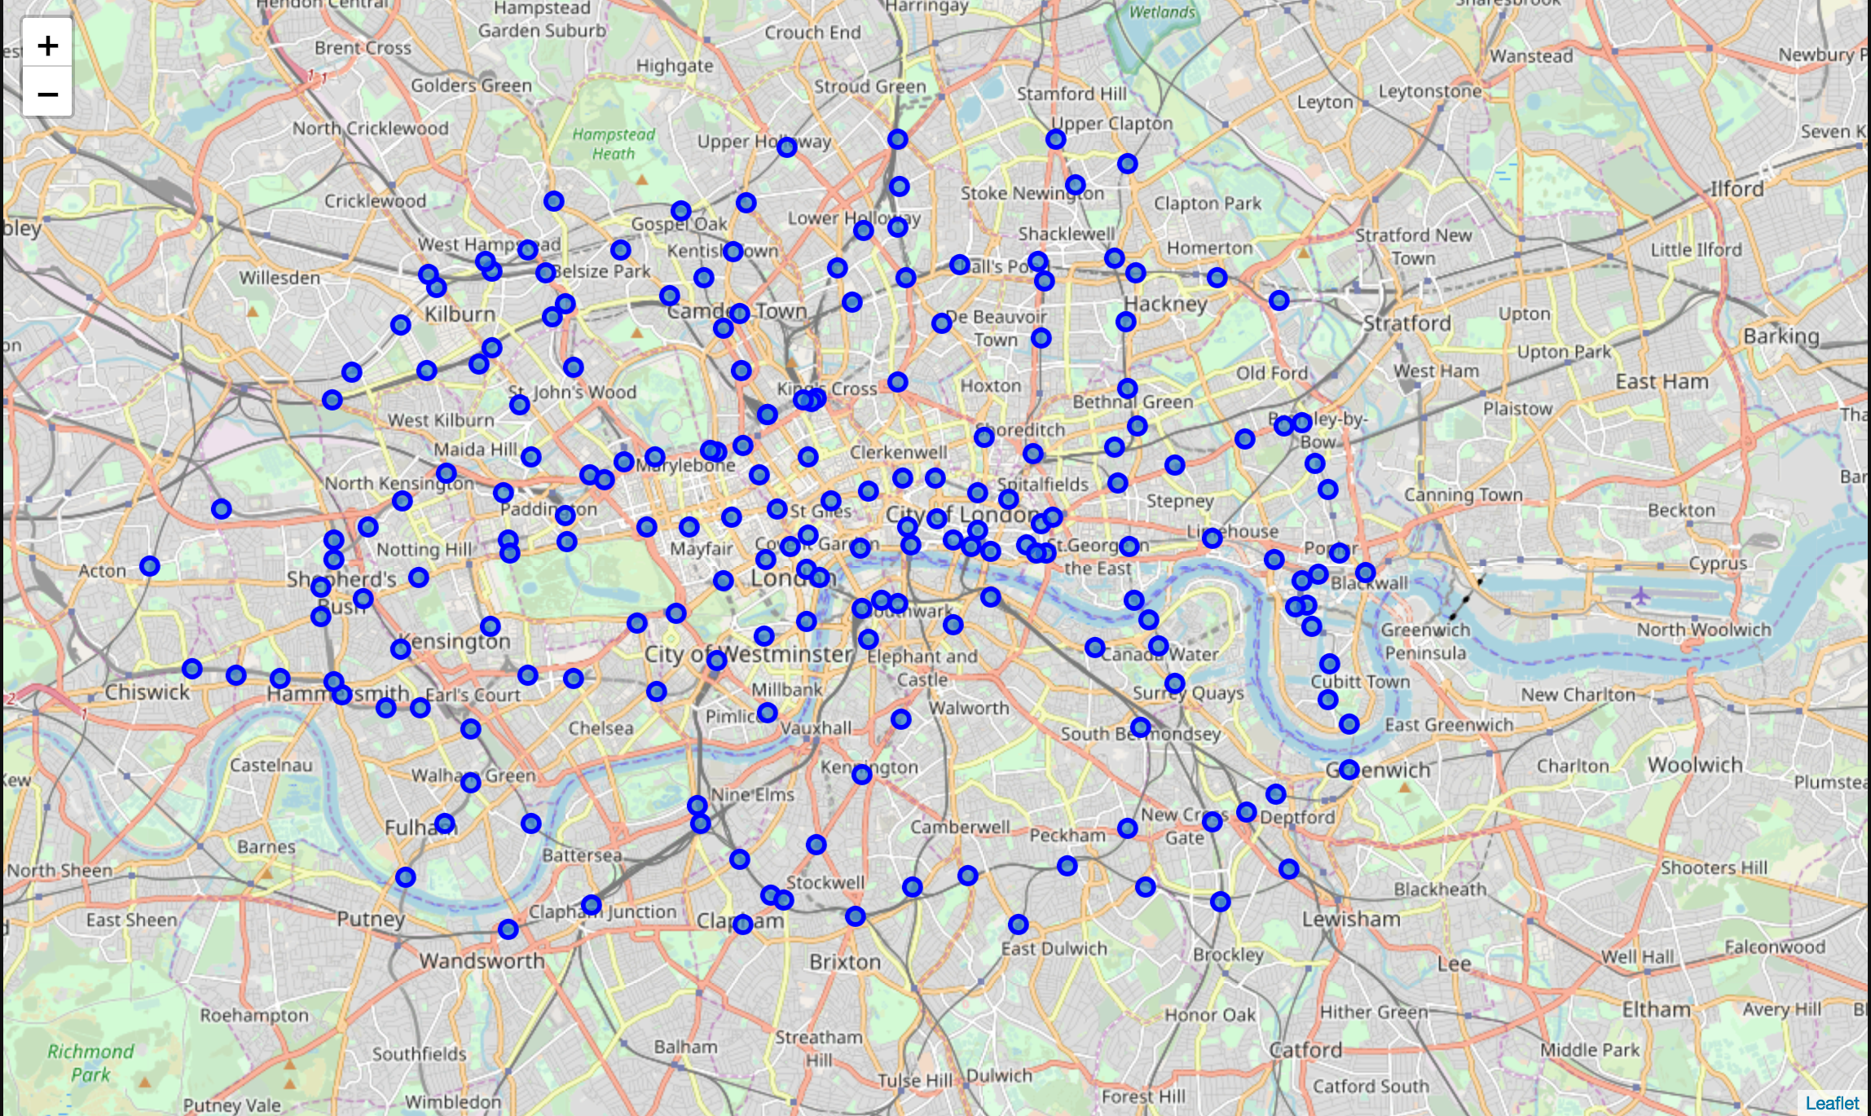
Un-clustered Map of London Underground

Slide 5
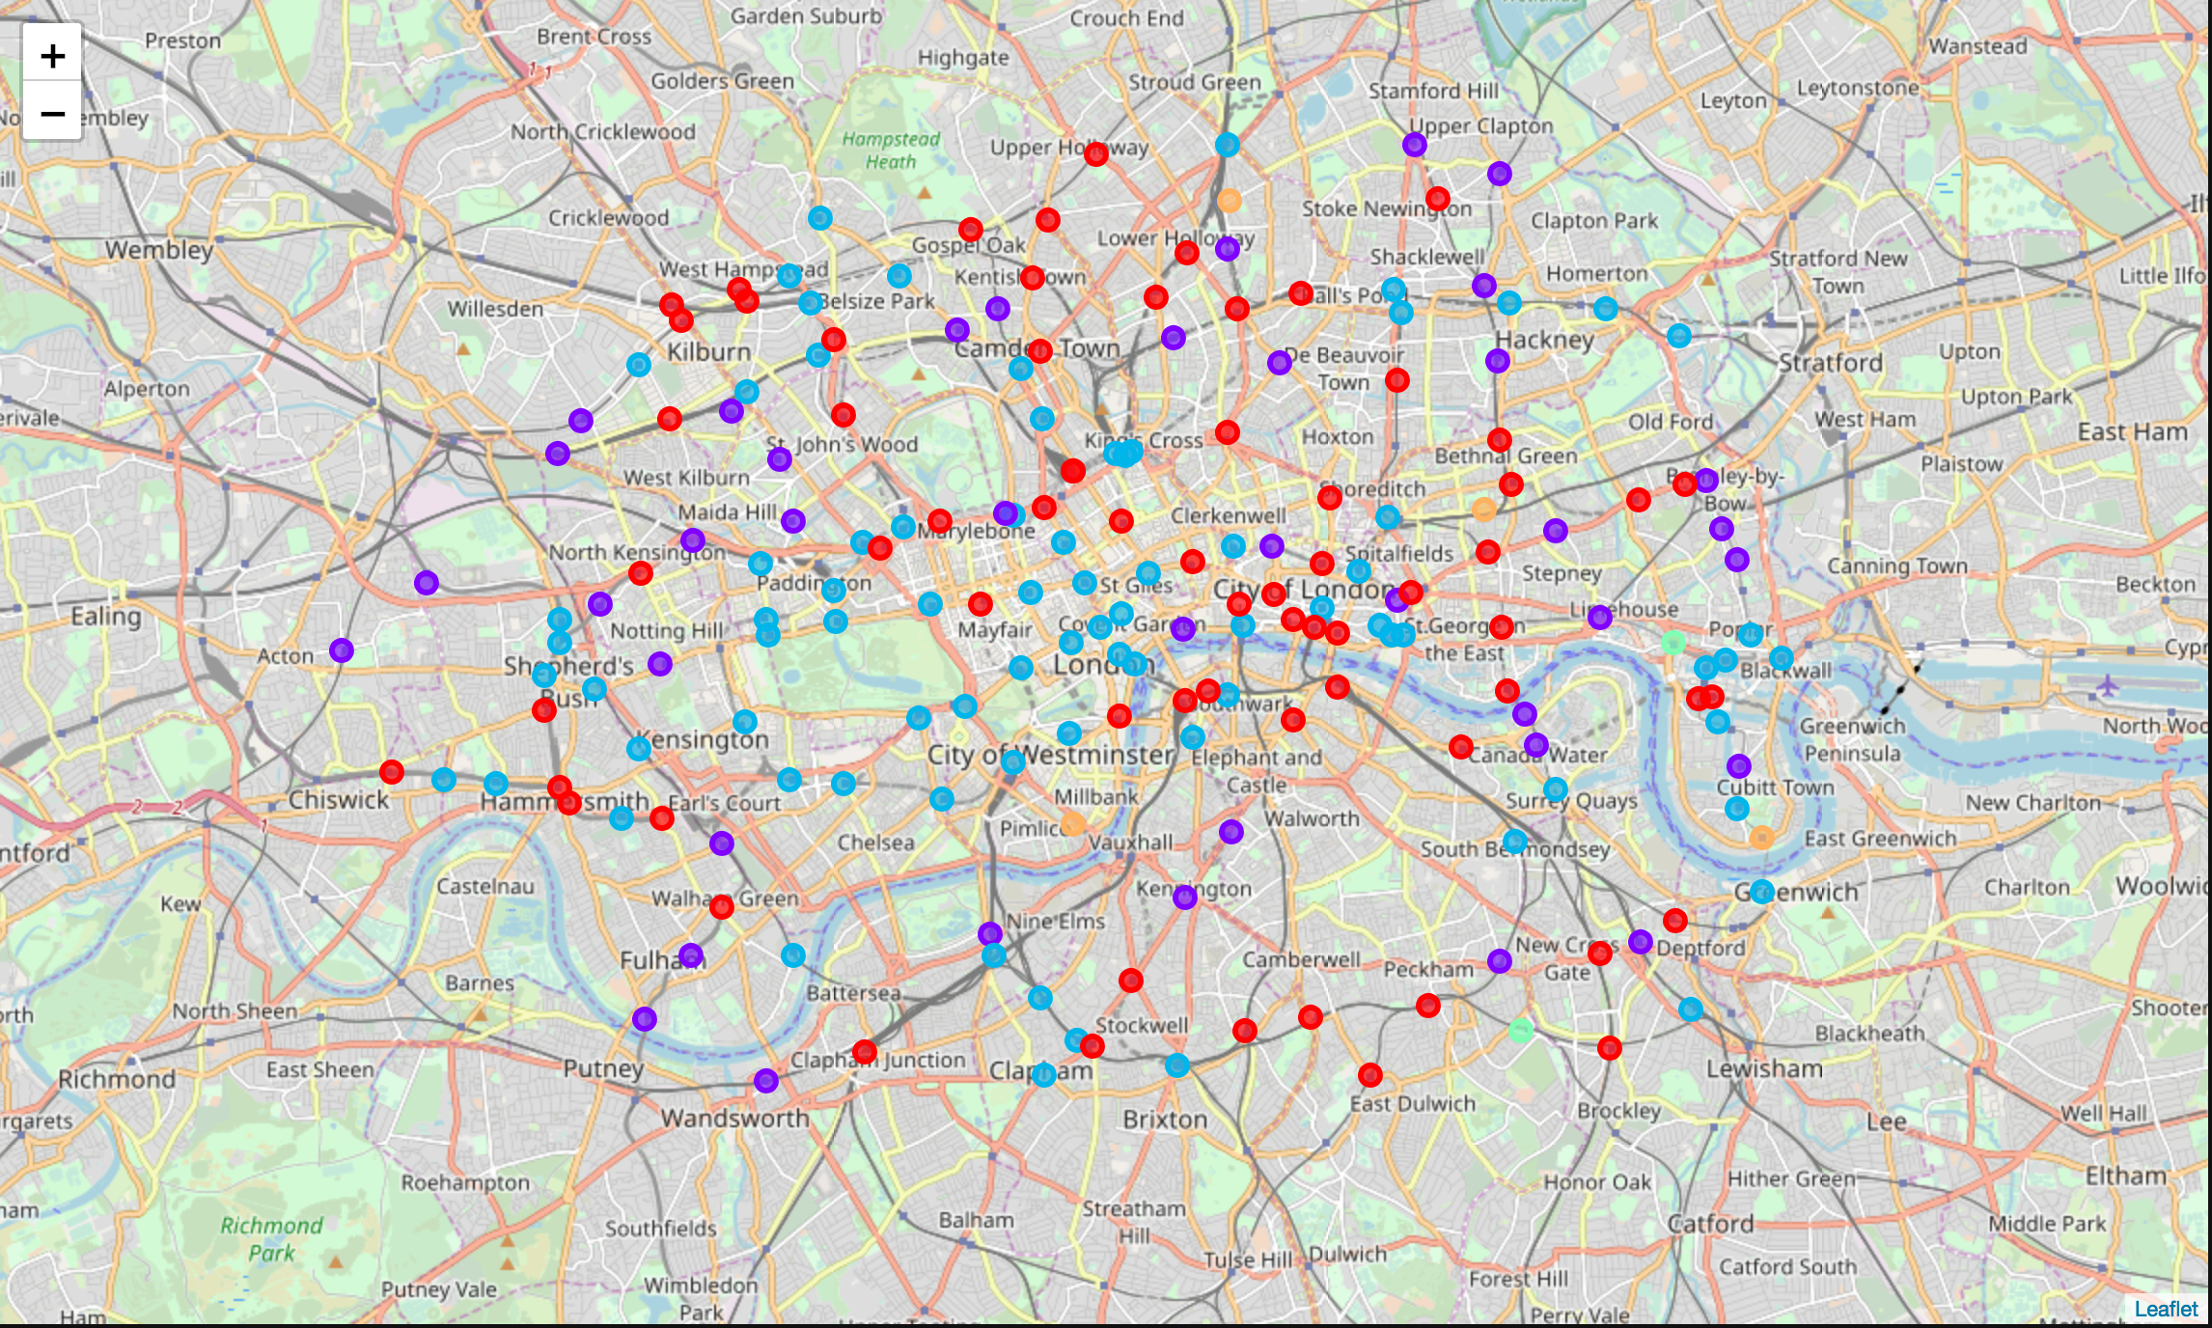
Clustered Map of London Underground
Red Cluster – Predominantly coffee shops and pubs with some convenience stores
Purple Cluster – Mainly pubs most common with bars and hotels
Blue Cluster – Restaurants and hotels with some retail shops
Green Cluster – Market stalls with some restaurants
Orange Cluster – Parks and sports facilities

